Slide 1
Image Compression Using PCA
Brent White
12-5-2018

Slide 2
Goals
Use linear algebra to solve the matrix so we can extract main components
Compress images of dogs using Principal Component Analysis to obtain the most visually appealing compressed image
Compare the effectiveness of our program by comparing an image to its accompanying 50%, 90%, and 99% explained version

Slide 3

Why use PCA?
PCA takes a realistic approach to compression matrix generation by gathering real images to use as data and attempts to find an underlying structure that is common amongst all pictures
Uses orthogonal transformations to turn a potentially correlated set of data into a linearly uncorrelated set of data which contain principal components

Slide 4


PCA in Business Applications
Save space in a database, and thus the company’s revenue, which is a beneficial and efficient way to store image data
When you have limited space, this is one of the best ways to store part of your data and revise it to images as close as possible to the original images
When you just want to identify what’s in the picture. Compressed data should be enough

Slide 5

So, what’s the plan?
Steps:
Transform image to matrix
Calculate covariance matrix
Find eigenvalues (to determine magnitude)
Find eigenvectors (principal components)
Multiply matrix with eigenvectors

Slide 6
Mathematical Background
If A is symmetric (meaning A^{T}= A), then A is orthogonally diagonalizable and has only real eigenvalues. That is, there exist eigenvalues λ1, . . . , λn and eigenvectors v₁, v₂ . . . ,v_{n} such that:
Av_{i} = λ_{i}v_{i} for each i = 1, 2, . . . , n.
This is the spectral theorem: A^{T}A and AA^{T} share the same eigenvalues and these eigenvalues are non-negative
So if we have have a matrix we can make it symmetric by calculating its covariance matrix.

Slide 7
Mathematical Application
First we scale the data. This reduces the emphasis caused by the larger data points in the raw data
We then compute the covariance matrix from our data thus:
S = AA^{T} /(n − 1)
This covariance matrix should show the main values. Our eigenvalues are derived from the covariance matrix:
Sample covariance matrix:
We then find the eigenvalues: λ₁, λ₂ , then the eigenvectors from these eigenvalues.
We use these eigenvalues and eigenvectors to identify the dog images
45 2
2 8

Slide 8
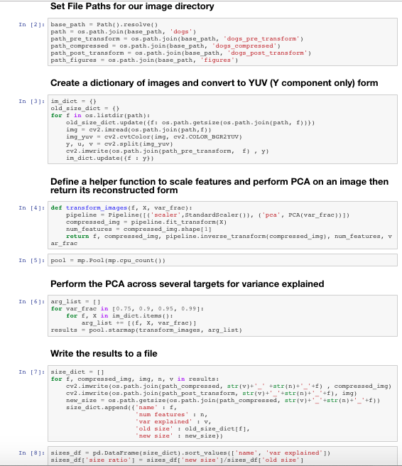
Code Sample
Step 1: Load data
Step 2: Convert RGB (color jpg files) to YUV and strip the Y component
Step 3: Define a function that fits sklearn PCA to an image and returns a reconstructed image using the fitted model
Step 4: Create a pool of workers and distribute application of the PCA to each worker for a variety of target variances
Step 5: Store results as .jpg files for comparison with originals
Notes:
standard scalar = x-u/s

Slide 9
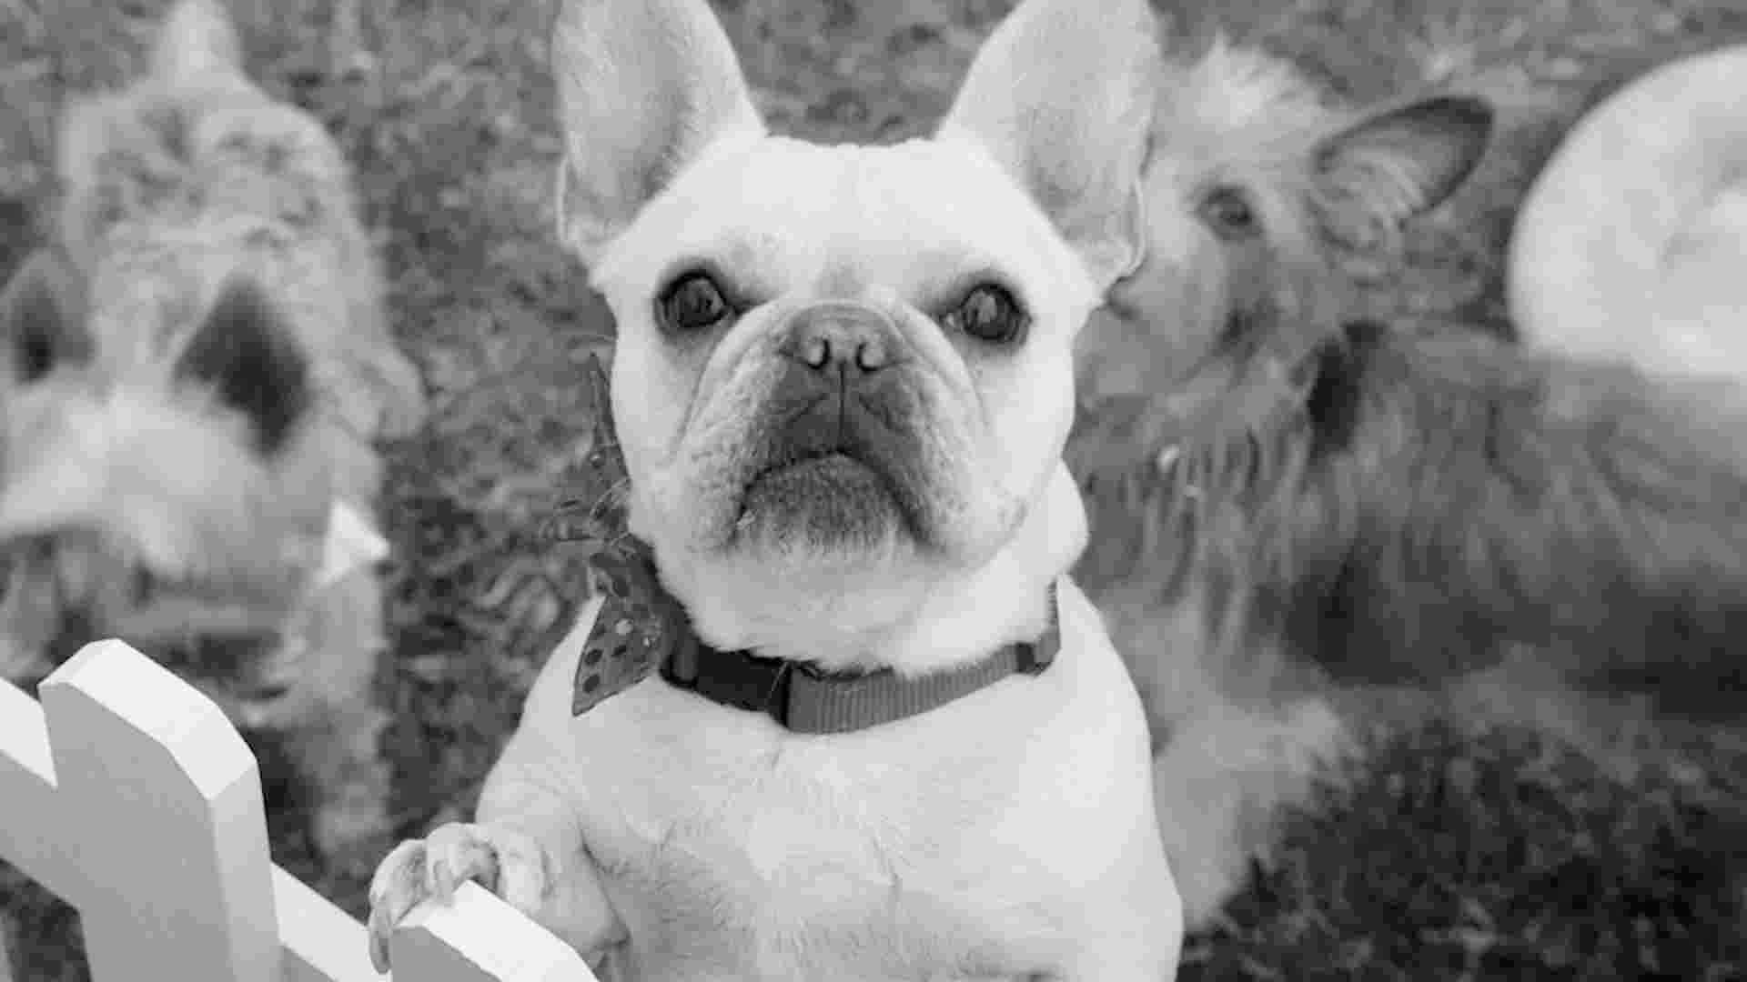
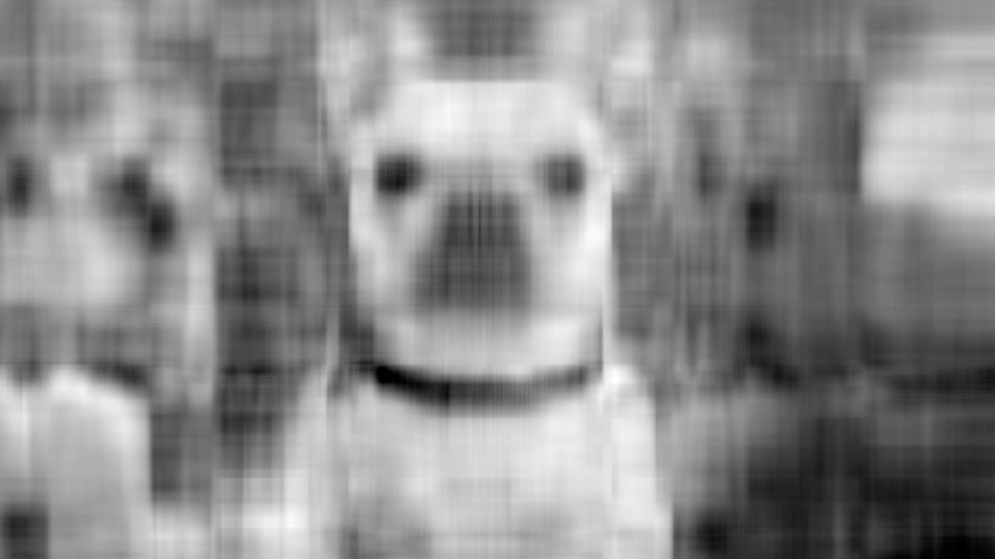


Image #1
Original
75% variance explained
90% variance explained
99% variance explained

Slide 10
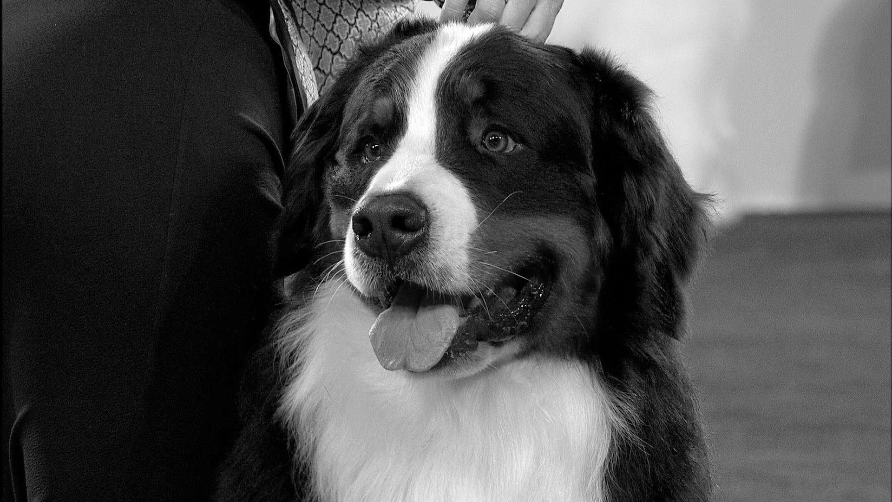
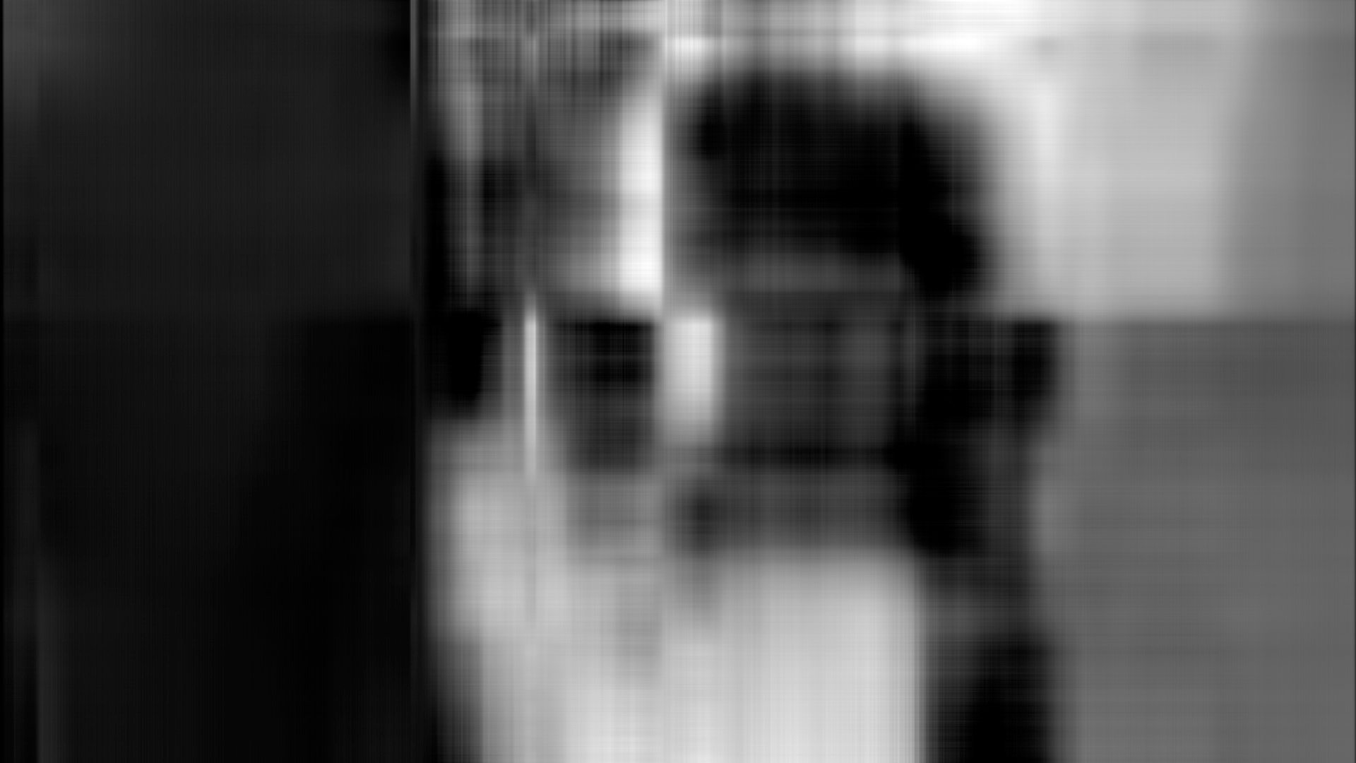


Image #2
Original
75% variance explained
90% variance explained
99% variance explained

Slide 11
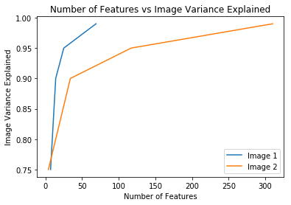
Results and Discussion
A small number of features (relative to the original) are able to explain the majority variance in both images
If we include more data on the amount of variance explained, the curve for Image 1 should look similar to that of Image 2

Slide 12
Results and Discussion
Even at 99% variance, compressed image size is greatly decreased
Looking at file size vs the number of features included in the compression, it is apparent that Image 1’s features are more rich

Slide 13
Conclusions & Future Work
The quantity of principal components (eigenvectors) used in the compression influences the recovery of the original image from the final (compacted) image.
The number of eigenvectors to keep depends on business need: to identify a pattern or just for storage
We will try to figure out what’s the smallest number of eigenvalues to keep so that machine can tell the difference between cats and dogs
Determine the best way to store PCA models

Slide 14
Sources
Jauregui Jeff, Principal Component Analysis with Linear Algebra, August 31 2012
http://www.scielo.br/scielo.php?script=sci_arttext&pid=S1679-45082012000200004
https://sebastianraschka.com/Articles/2014_pca_step_by_step.html#drop_labels
https://scikit-learn.org/stable/modules/generated/sklearn.decomposition.PCA.html

